Slide 1
ООО “ВирКрафт Инжиниринг”
Индекс : 350088 Краснодарский край г. Краснодар улица Сормовская № 185 офис 15
Тел/Факс : 8 (861) 260-36-39

Slide 2
INTRODUCTION OF THE COMPANY
VIRKRAFT ENGINEERING Company was founded in 2007 as a partnership between two Turkish private entrepreneur business men, for the design, construction and turn-key projects of HVAC Systems of the Building and Industrial Mechanical Systems in Russian Federation and overseas.
VIRKRAFT ENGINEERING Company today has very strong management and staff personnel, technicians and qualified workers and necessary experience, and offers its qualified and reliable services particularly in the following fields on turn-key basis;
* Hotel, Motel construction of HVAC Systems * Housing Complexes HVAC Systems including infrastructure * Shopping Malls HVAC Systems including infrastructure * Business Centers construction of HVAC Systems including infrastructure * Exhibition and Museum Centers construction of HVAC Systems
* Sport Complexes construction of HVAC Systems * Entertainment Centers construction of HVAC Systems * Hospitals construction of HVAC Systems including infrasructure * Pipeline and Pump Station construction * Boiler Plant design and construction * Sewage Treatment Plant construction
* Complete Fire Protection Systems
* Industrial Mechanical Systems
VIRKRAFT ENGINEERING Company today is actively executing the above mentioned projects in Russian Federation.
Manpower :
Since the establishment of the Company, VIRKRAFT ENGINEERING employs very qualified personnel and laborers, of which 14 are mechanical engineers and technicians and the rest are administrative personnel, foremen, skilled laborers and unskilled laborers.

Slide 3
COMPLETED PROJECTS
The Naberezhnaya Tower project Moscow / Russia
IKEA Mega Shopping Center Project Omsk / Russia
IKEA Mega Shopping Center Project Samara / Russia Novotel Yekaternburg / Russia Sedmoye Nebo Shopping Center Yekaternburg / Russia 20-Storied Residential Building Saratov / Russia
ONGOING PROJECTS
Azimut Hotel Adler / Sochi / Russia
Rixos Apart Hotel and Residances Krasnaya Polyana / Sochi / Russia
+540 Project No: 41
Marriott Hotel Krasnaya Polyana / Sochi / Russia
+540 Project No: 39 Rixos Apart Hotel and Residances Krasnaya Polyana / Sochi / Russia
+960 Project No: 12-13 Almaz shopping Center Chelyabinsk / Russia 230 .000 m2

Slide 4
Sample Photographs of Former Installations and Photos

Slide 5
THE NABEREZHNAYA TOWER PROJECT IN MOSCOW CITY

Slide 6
THE NABEREZHNAYA TOWER

Slide 7
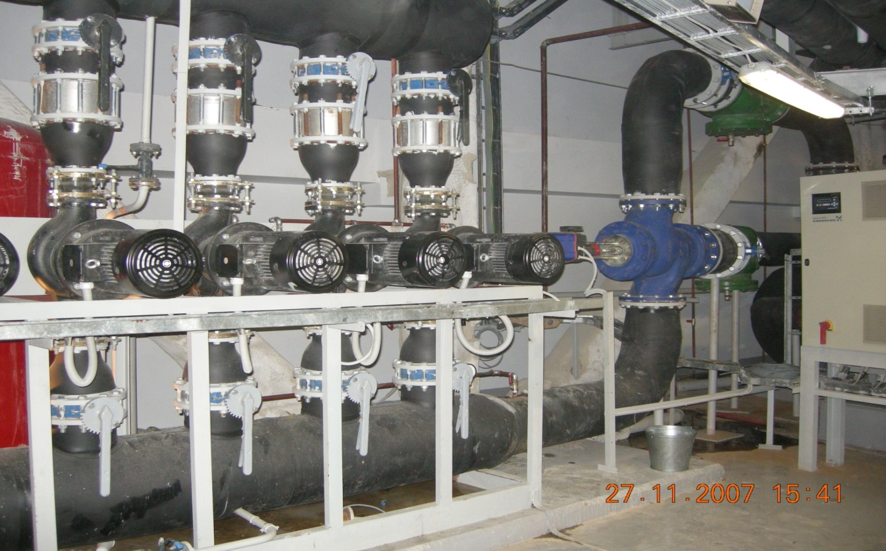

Slide 8
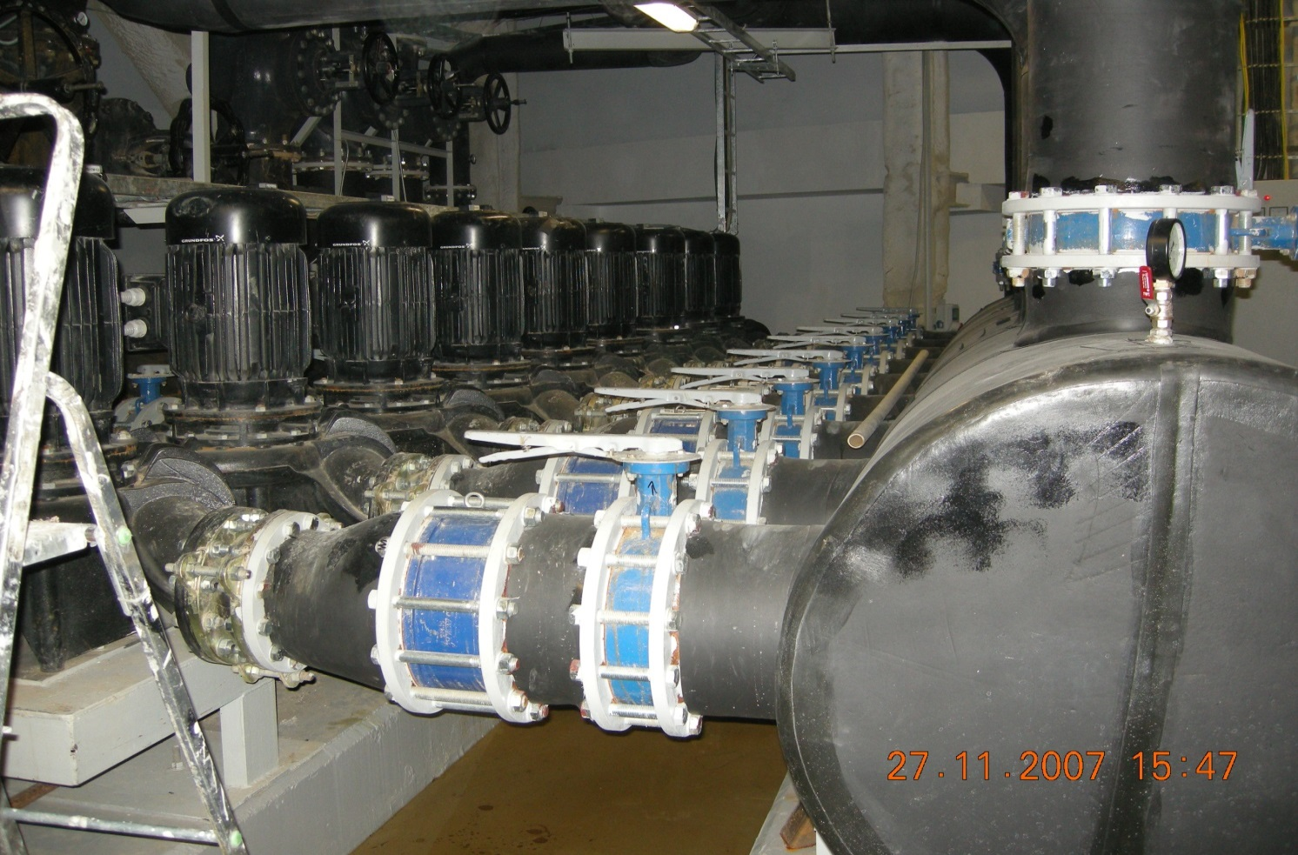

Slide 9
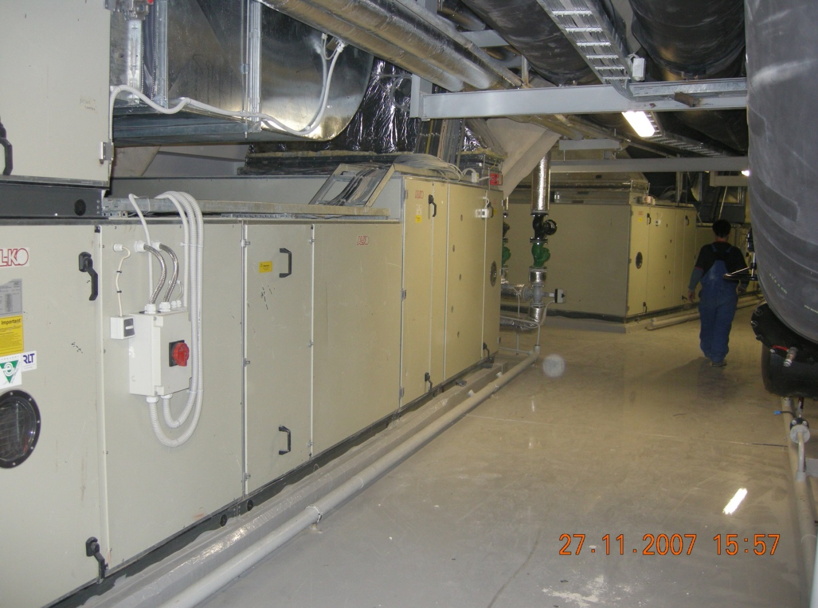

Slide 10
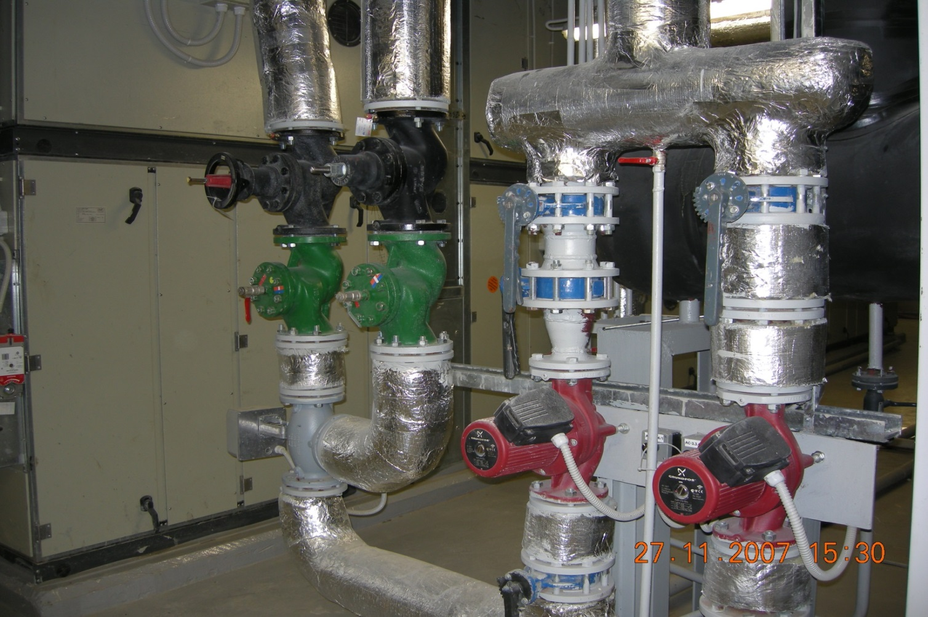

Slide 11
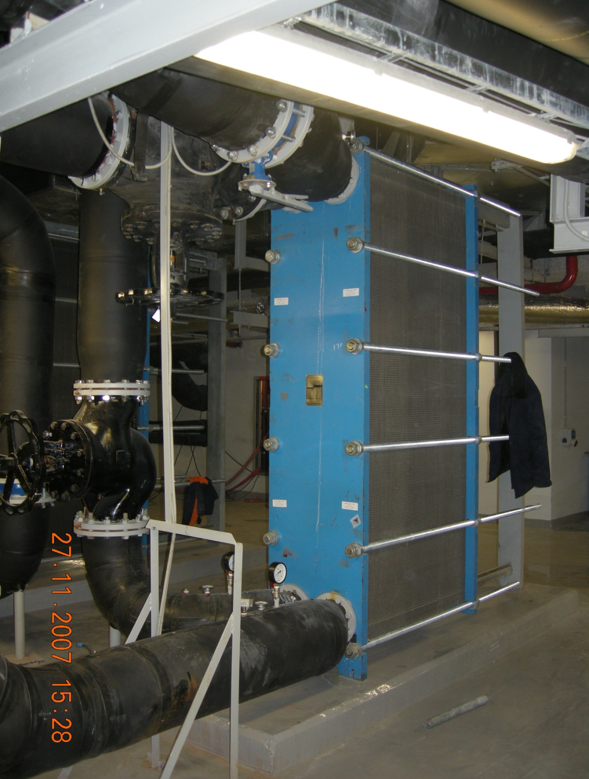

Slide 12
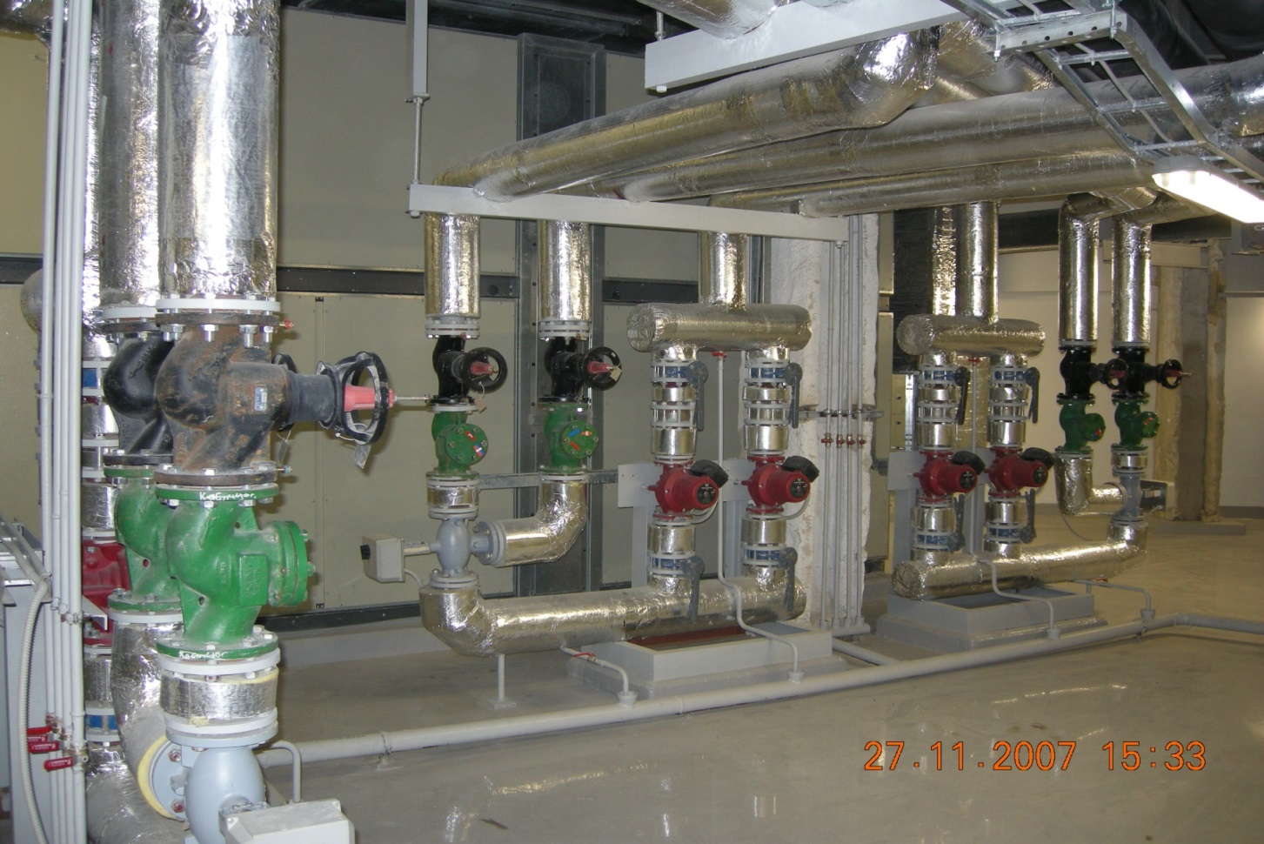
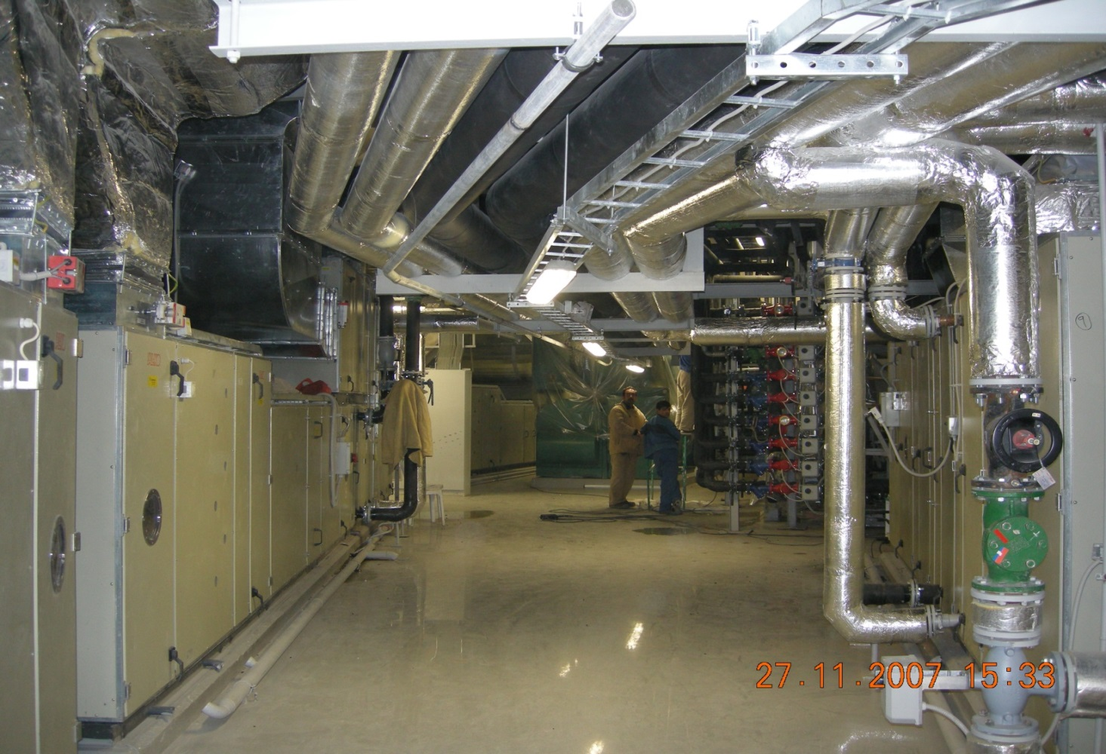

Slide 13
IKEA Mega Shopping Center Project 161.400m² Omsk / Russia

Slide 14
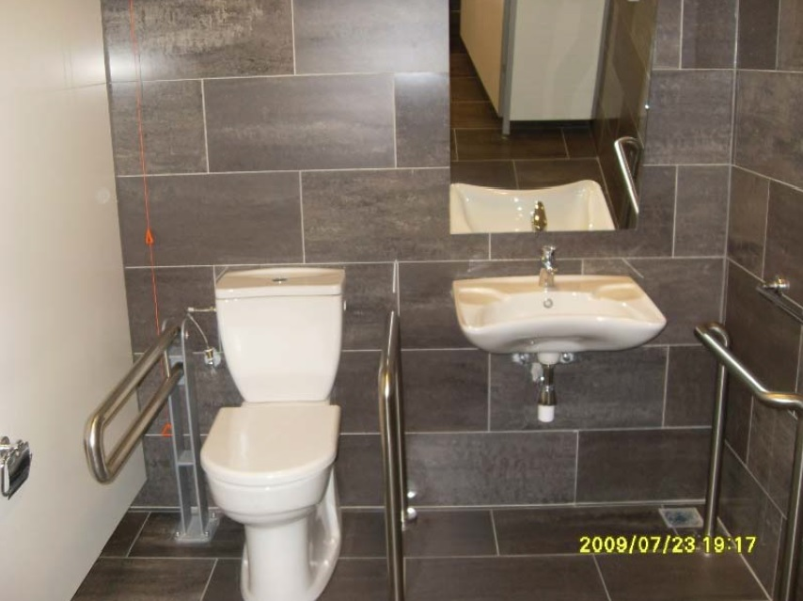
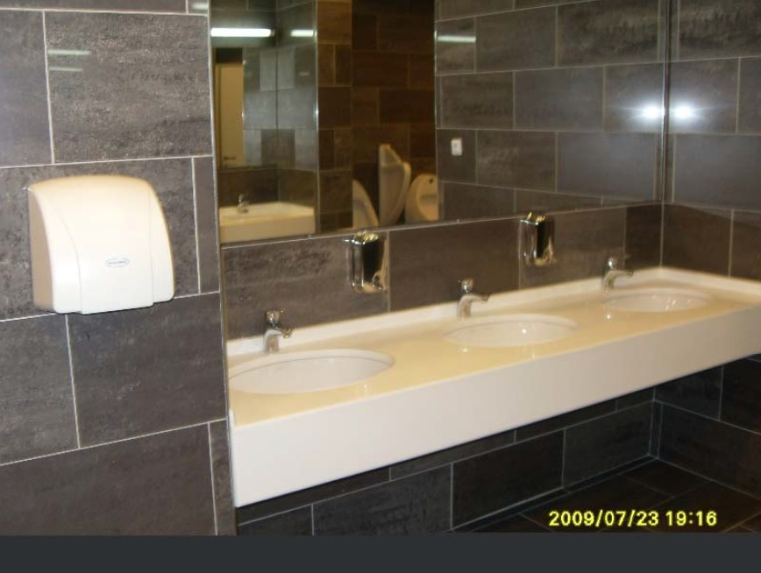

Slide 15
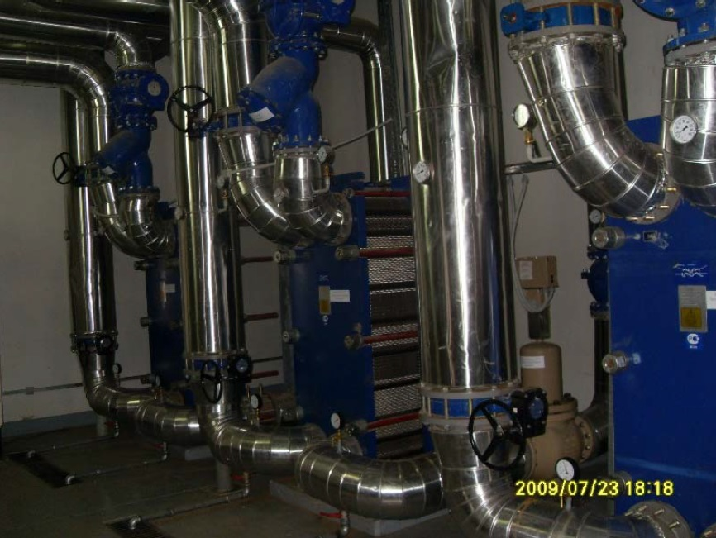
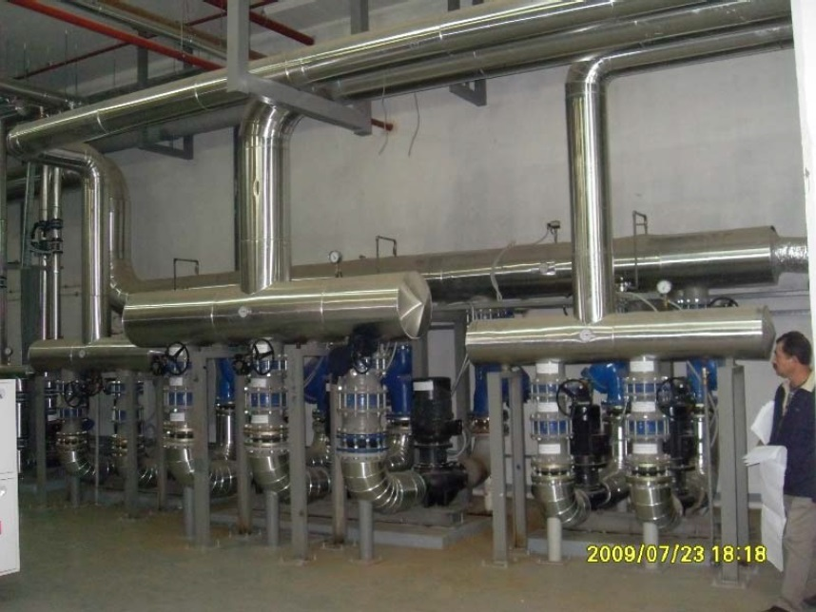

Slide 16
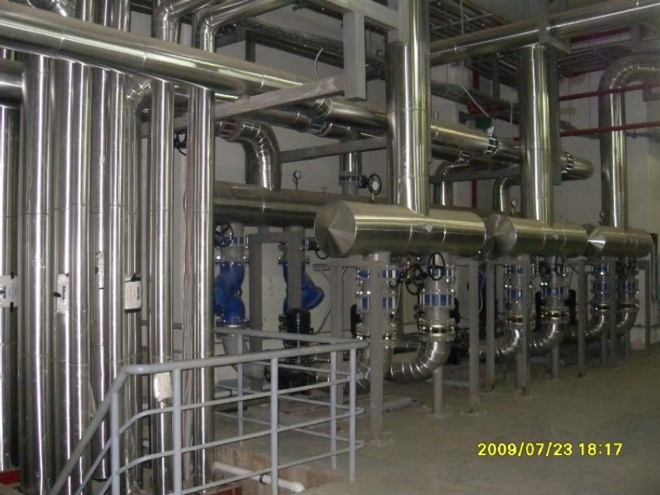
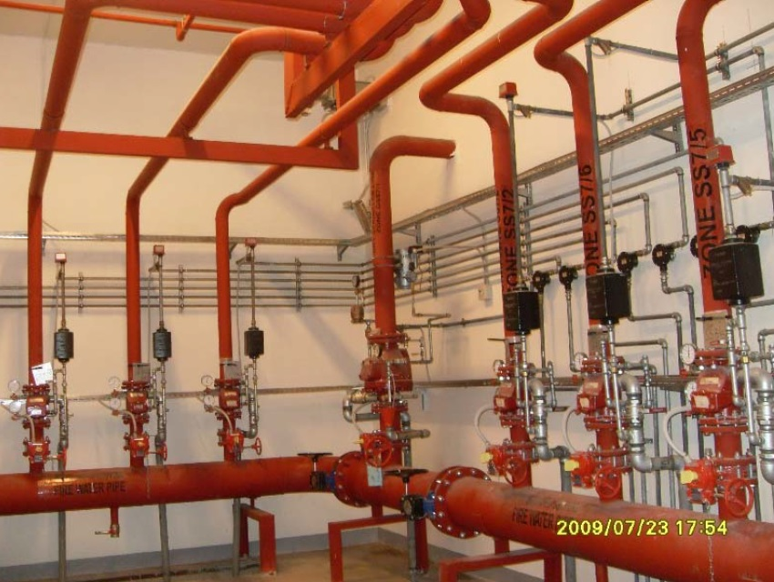

Slide 17
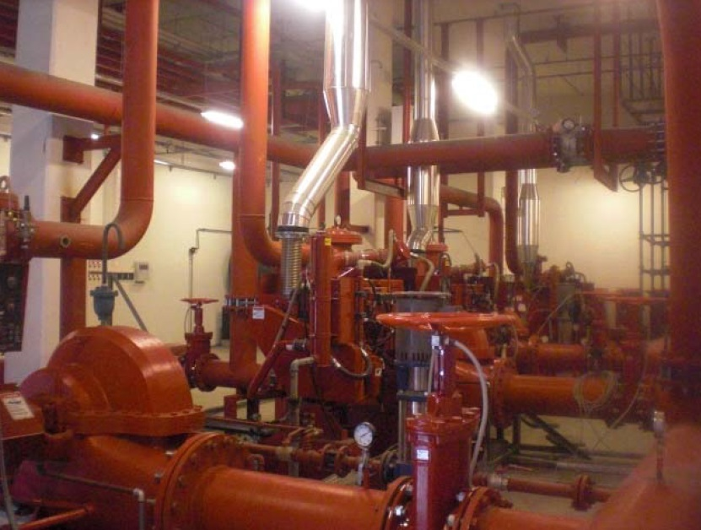
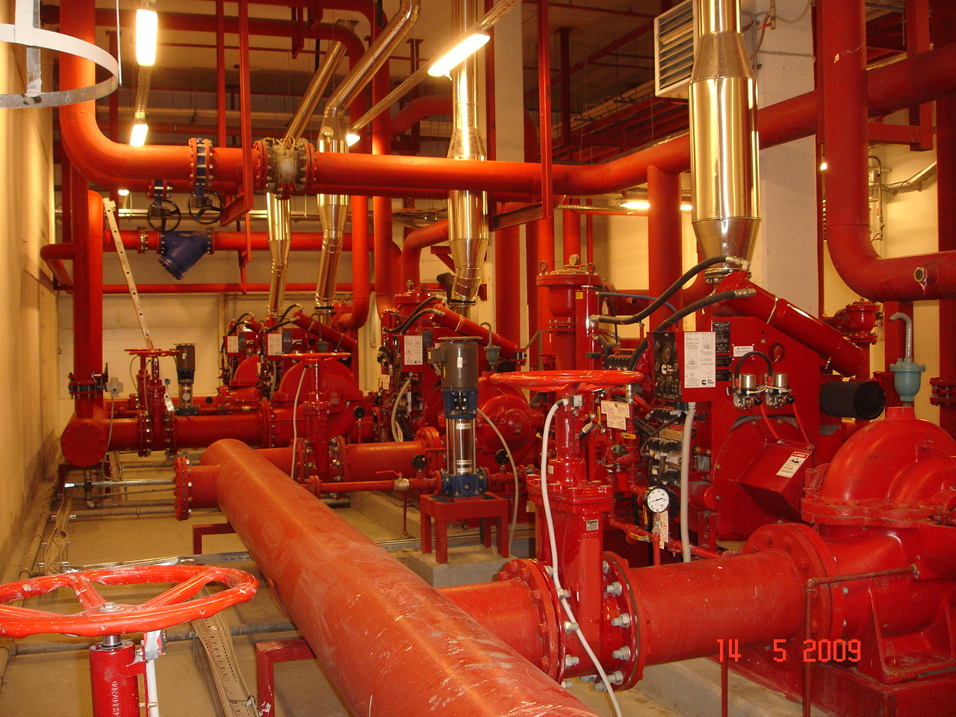

Slide 18
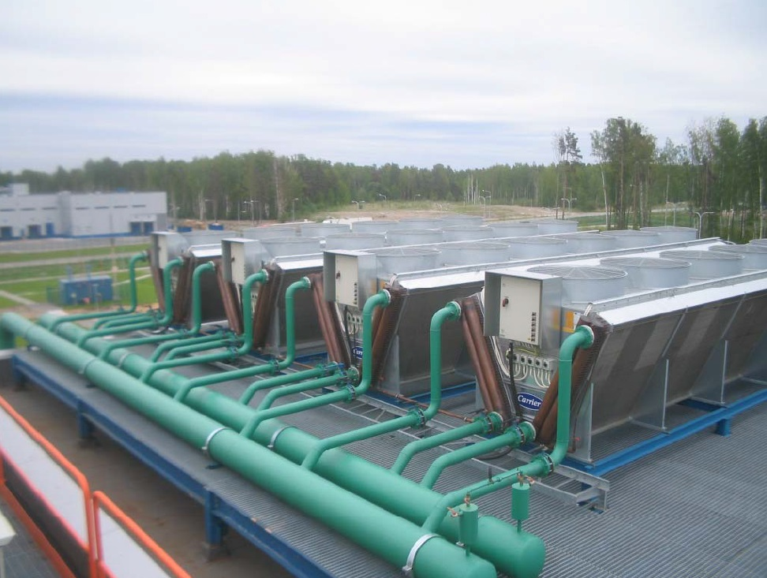
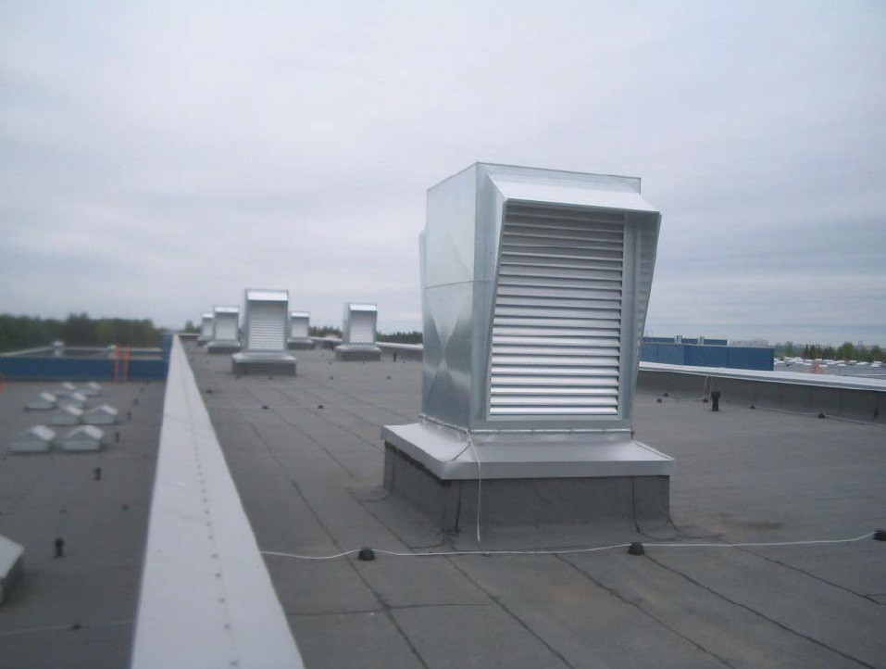

Slide 19
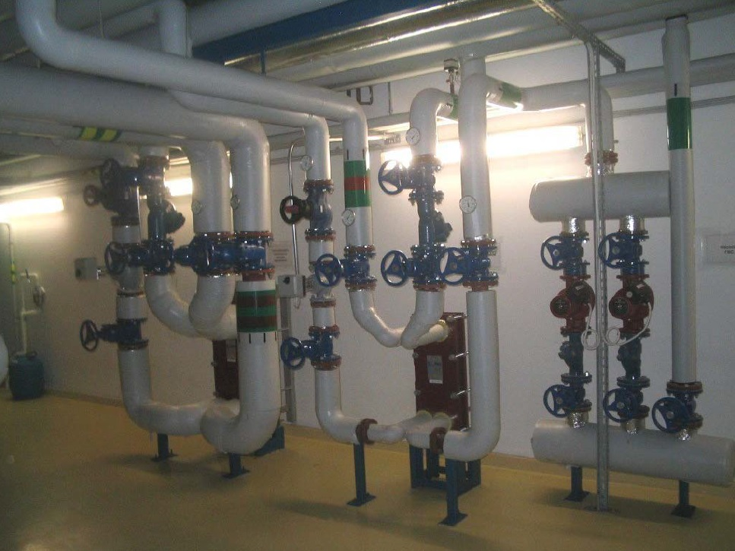

Slide 20
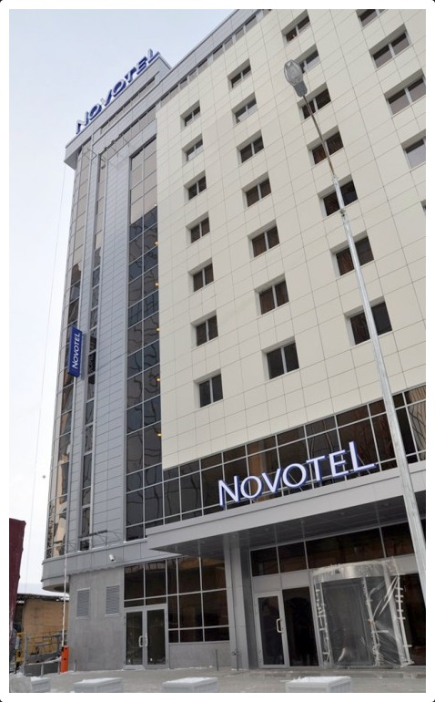
NOVOTEL YEKATERNBURG

Slide 21
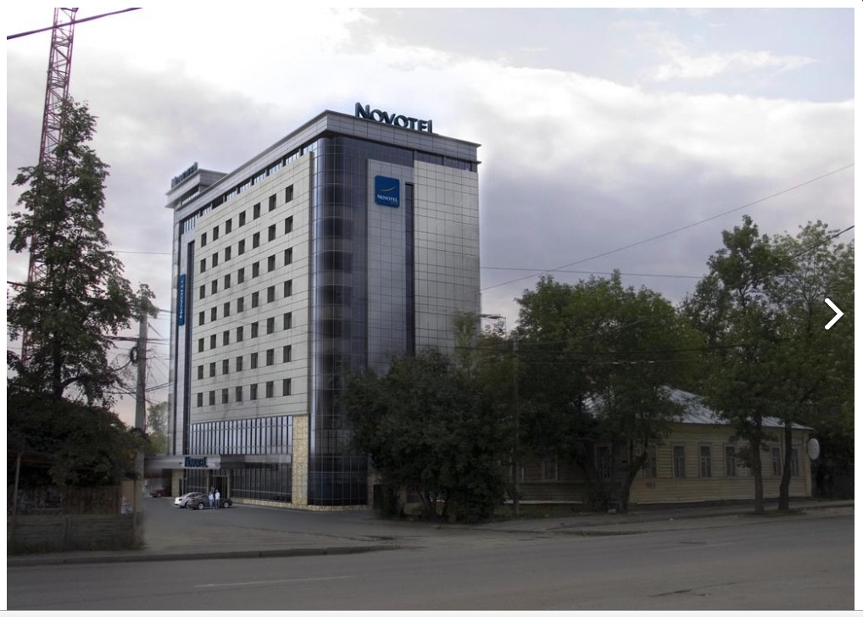

Slide 22
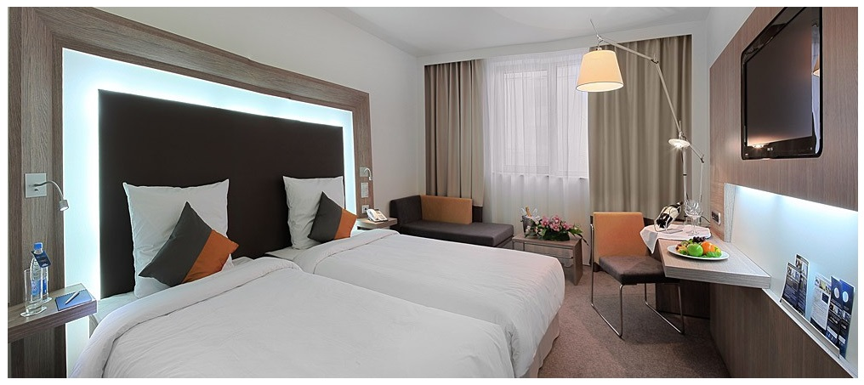
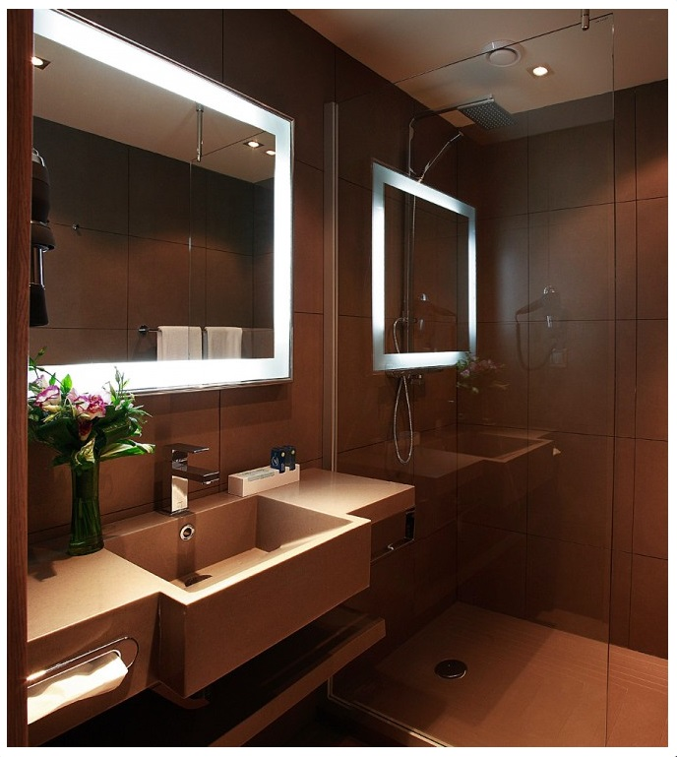

Slide 23
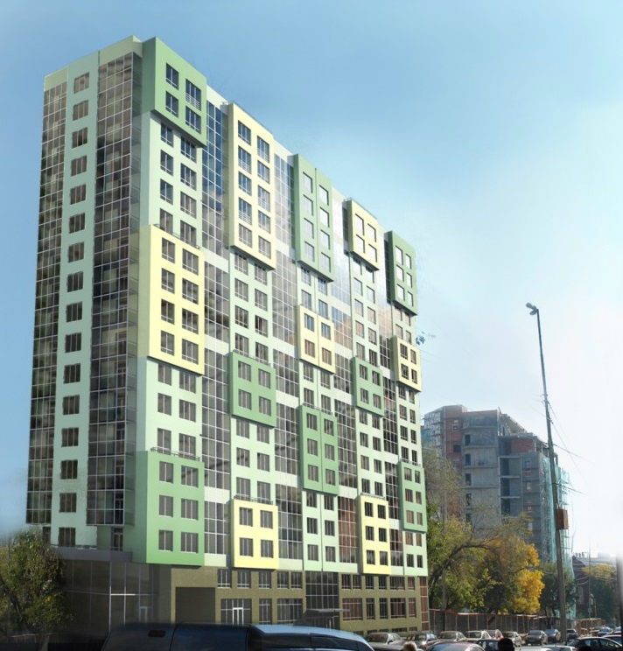
20-Storied Residential Building Saratov

Slide 24
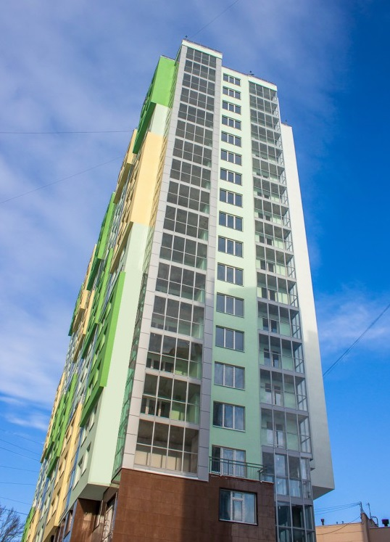

Slide 25
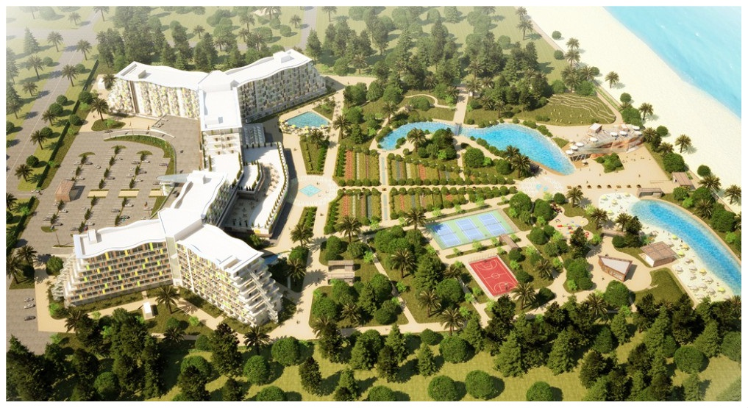
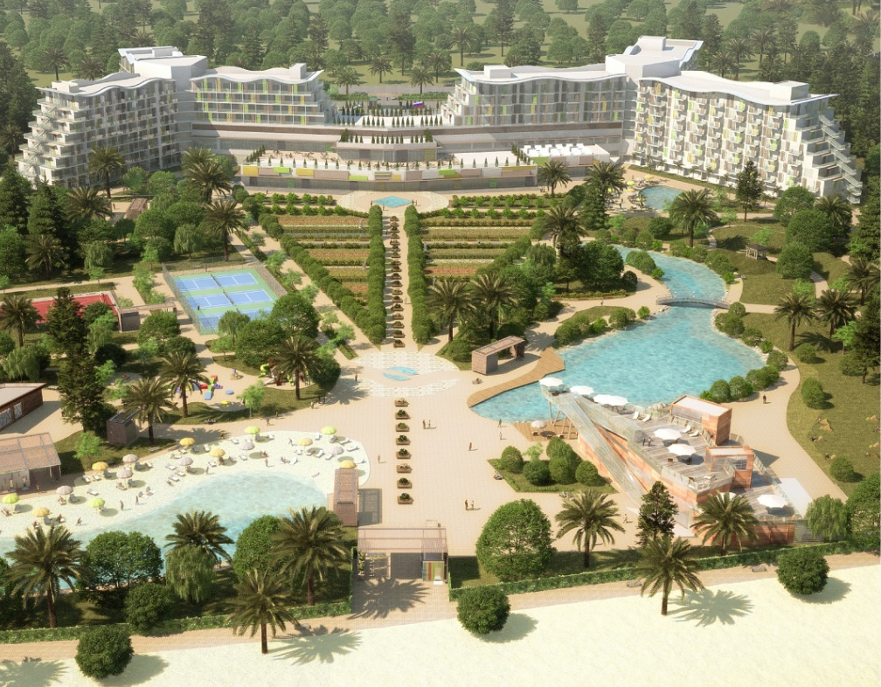
AZIMUT OTEL Adler / Sochi / Russia

Slide 26
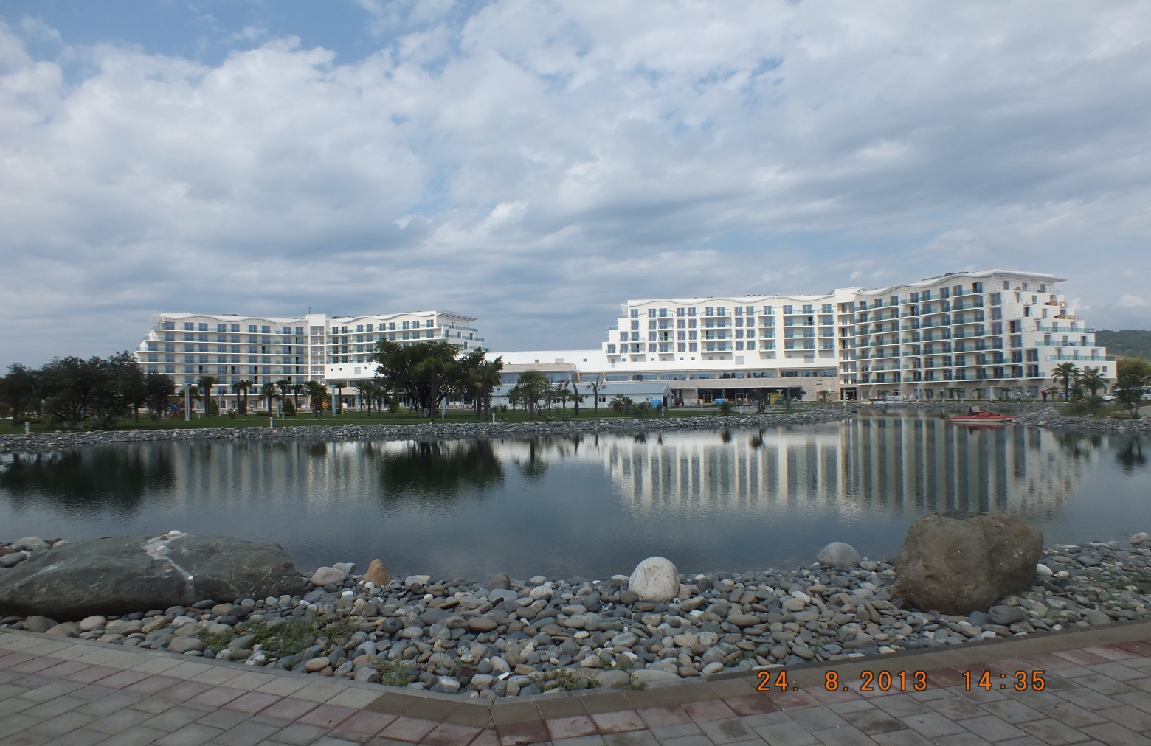
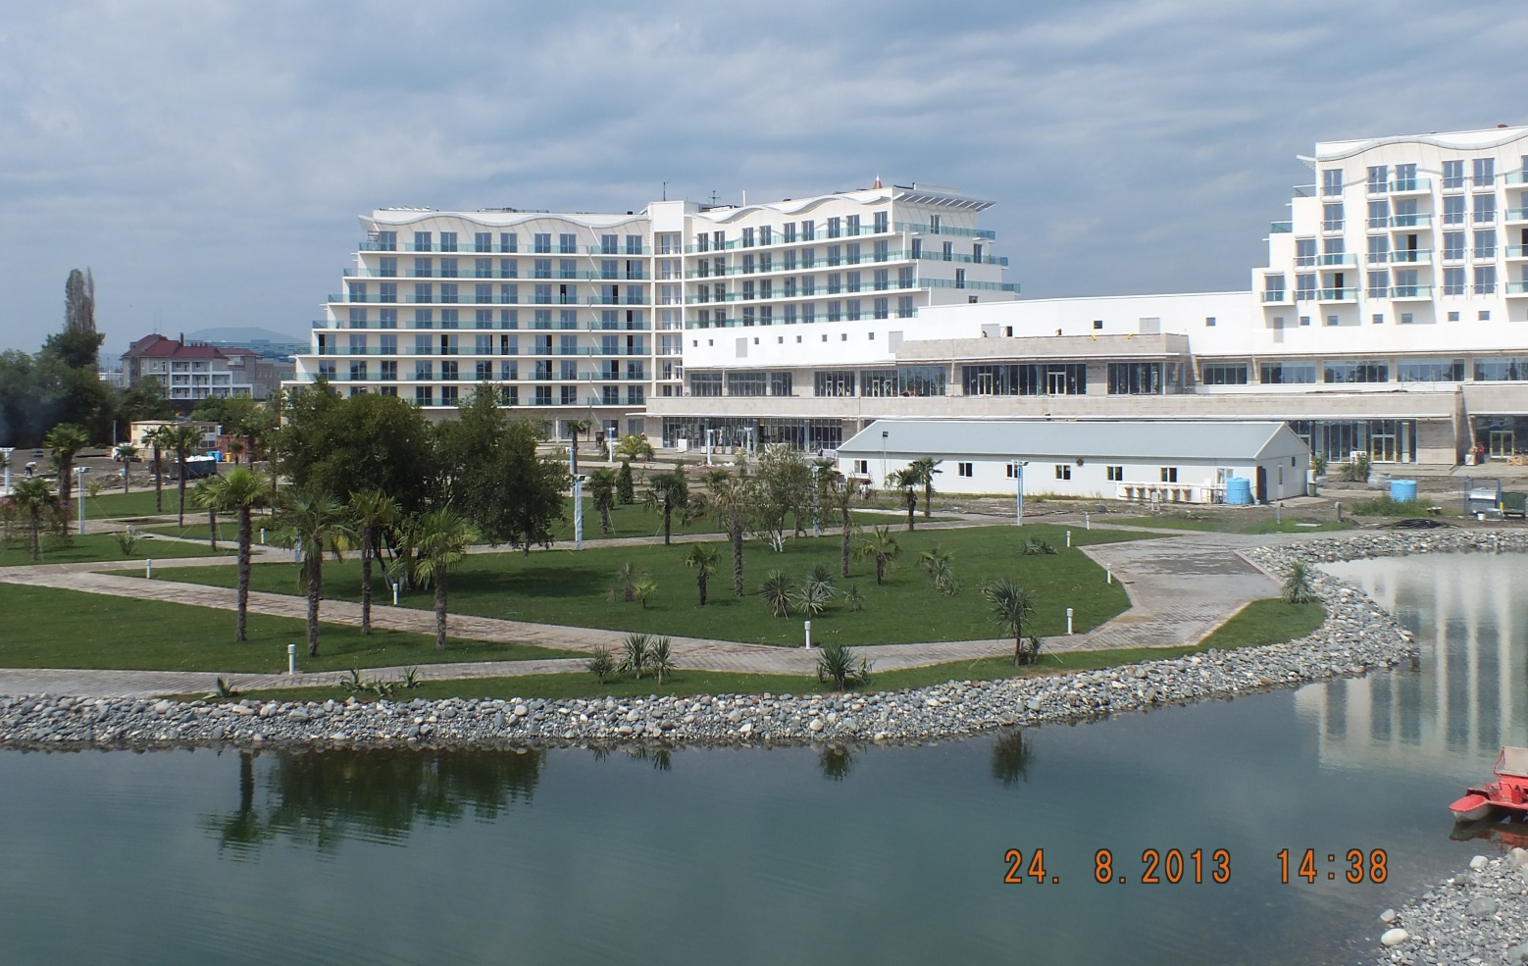

Slide 27
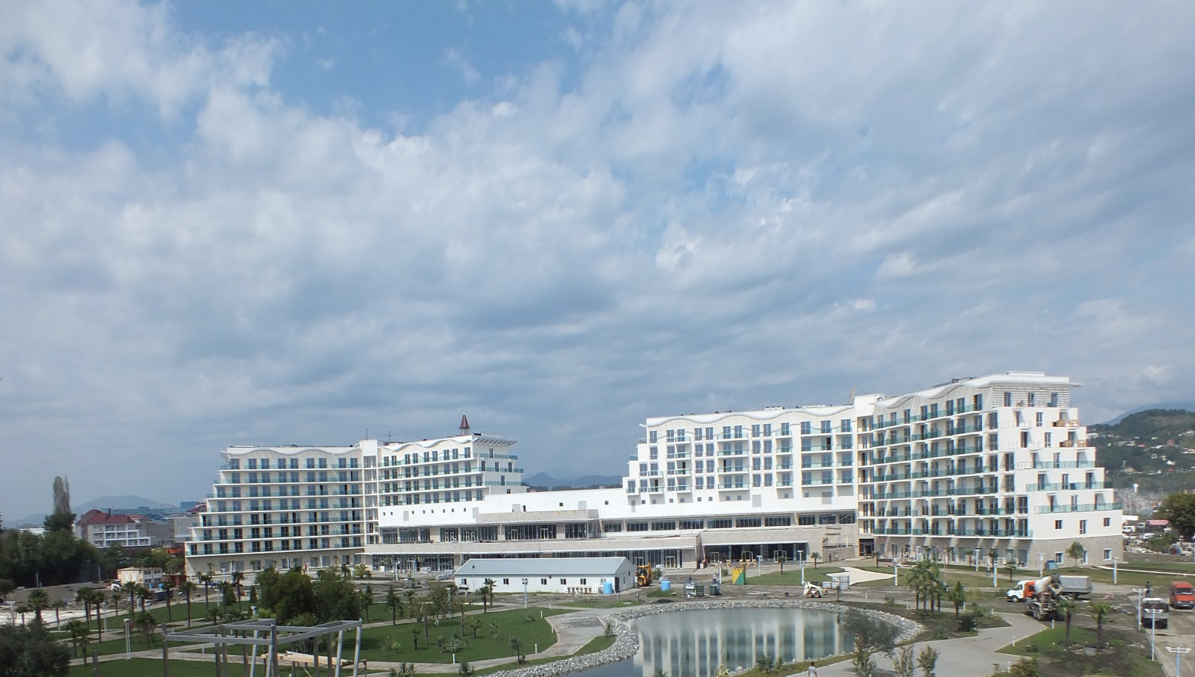
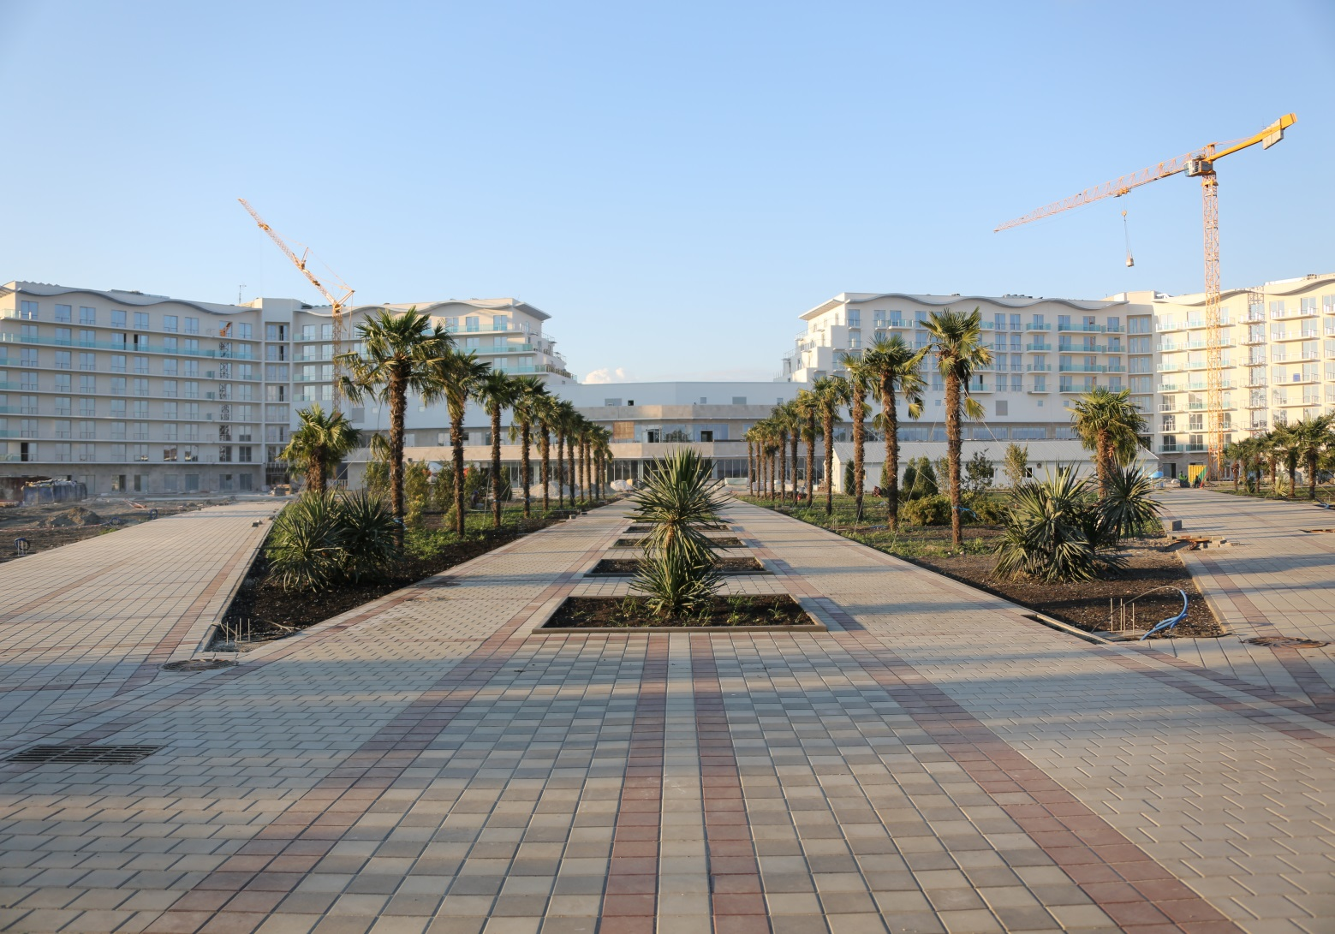

Slide 28
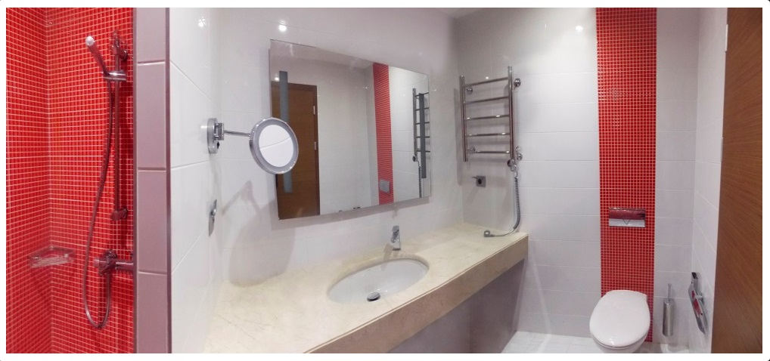

Slide 29
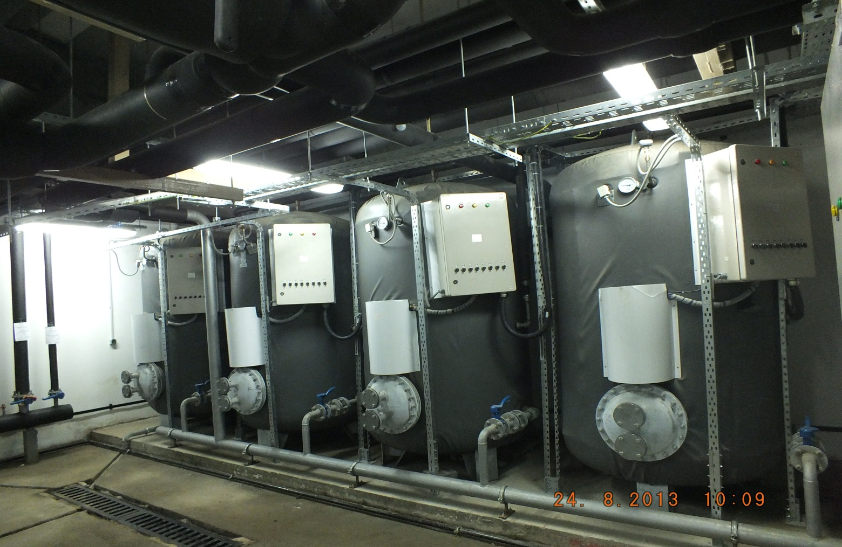
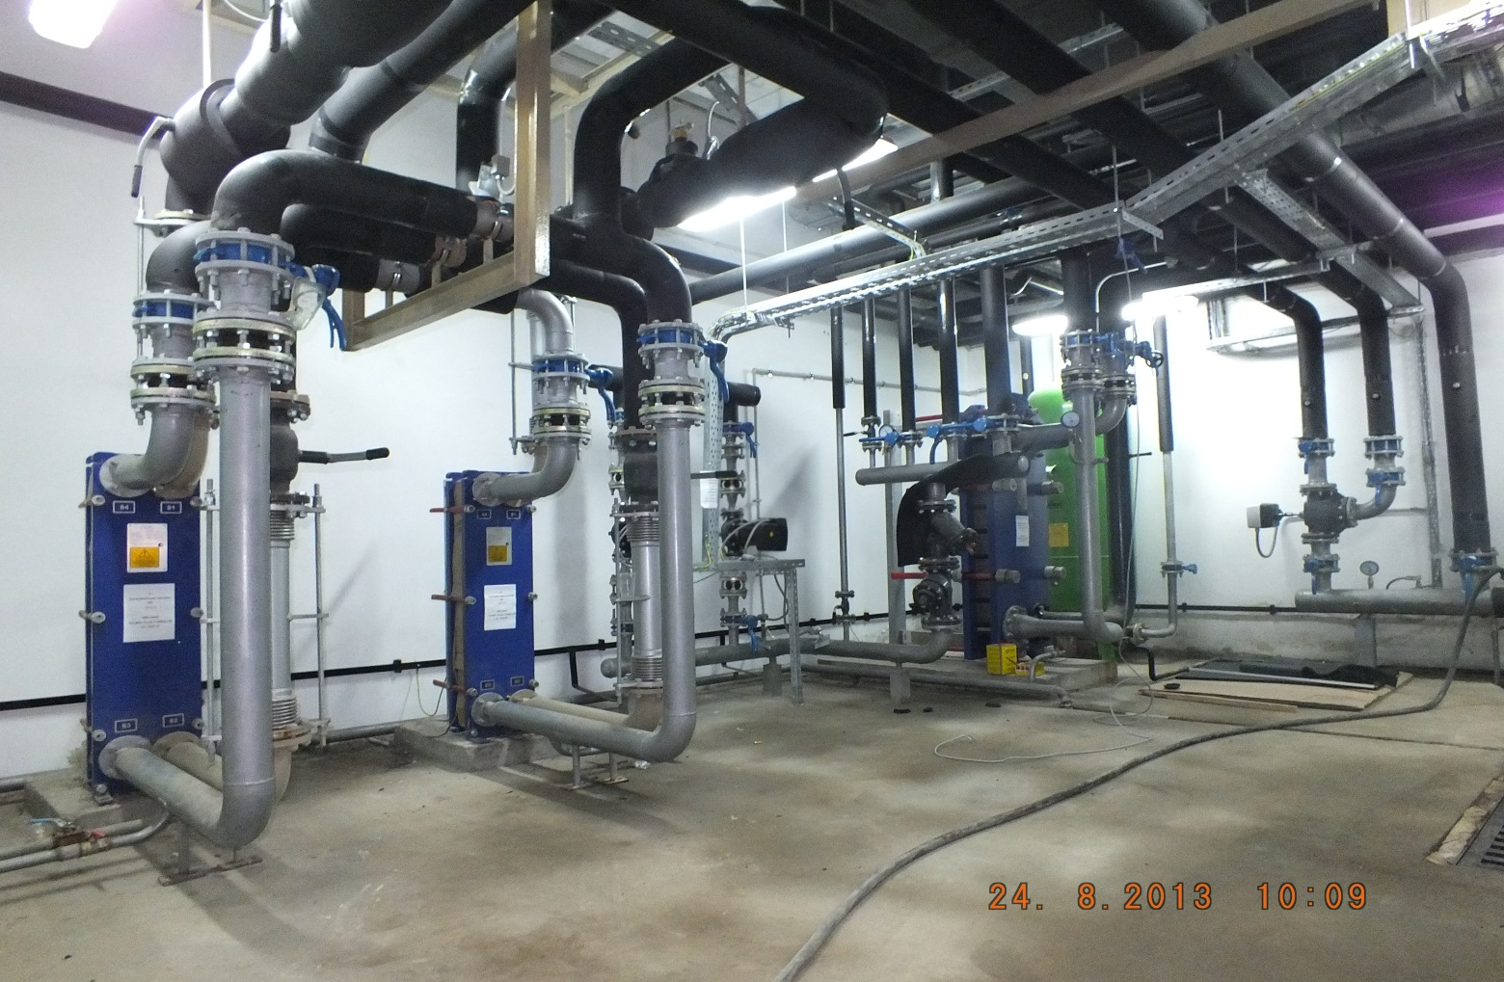

Slide 30
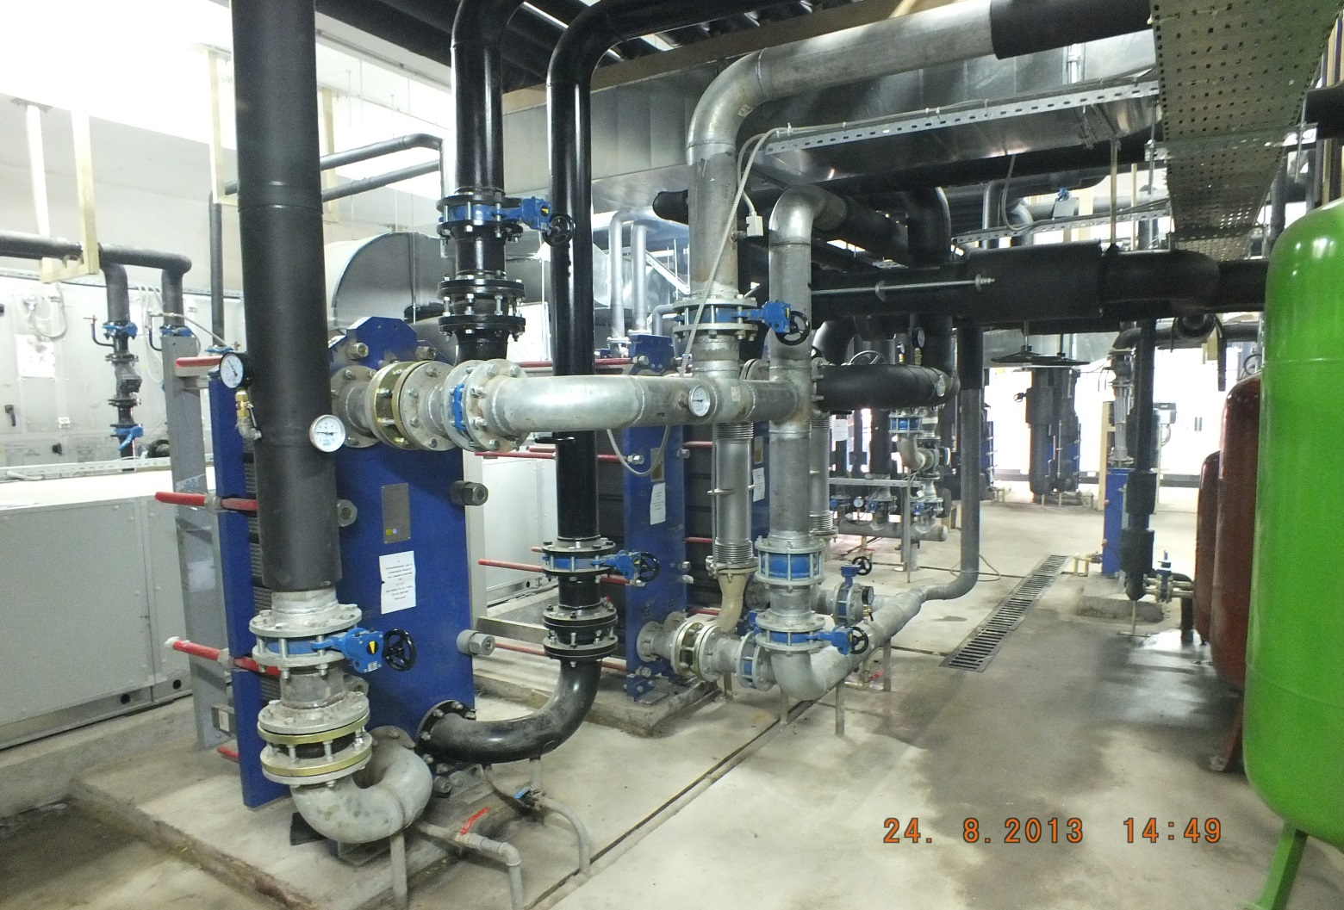
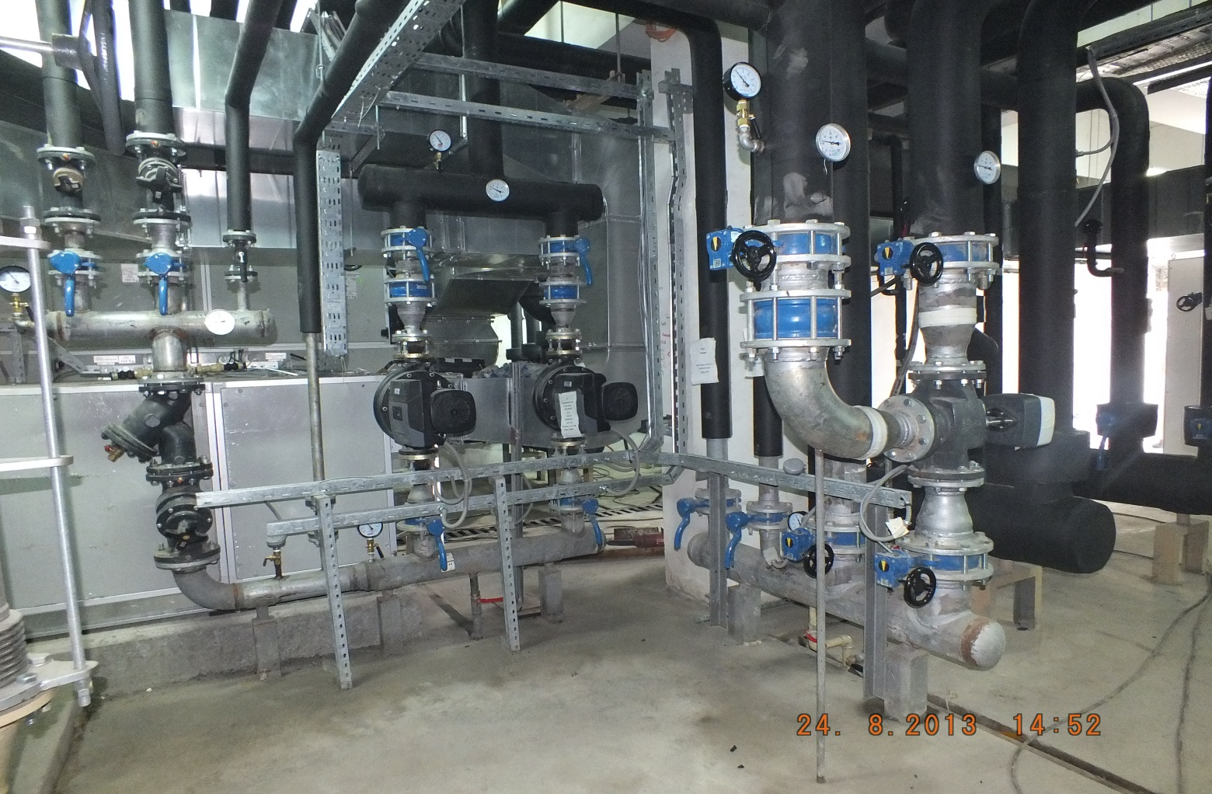

Slide 31
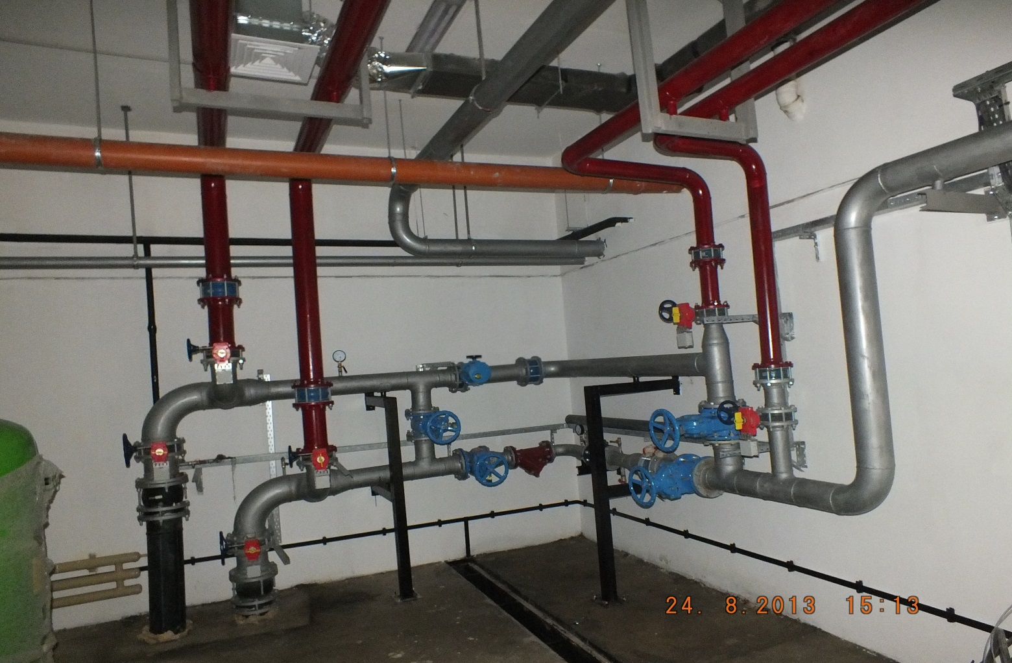
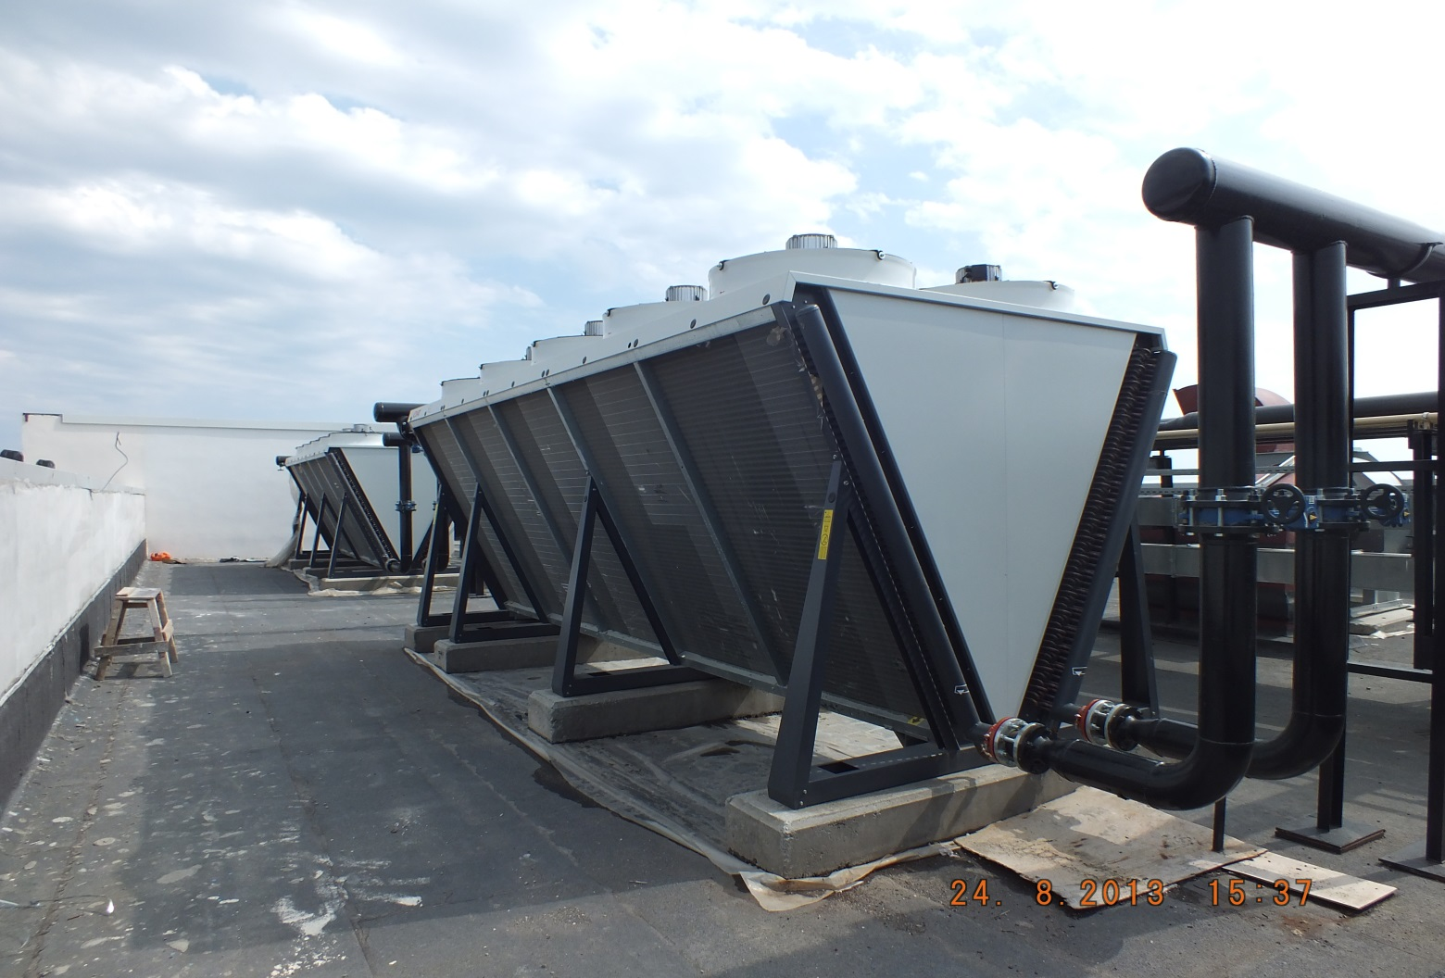

Slide 32
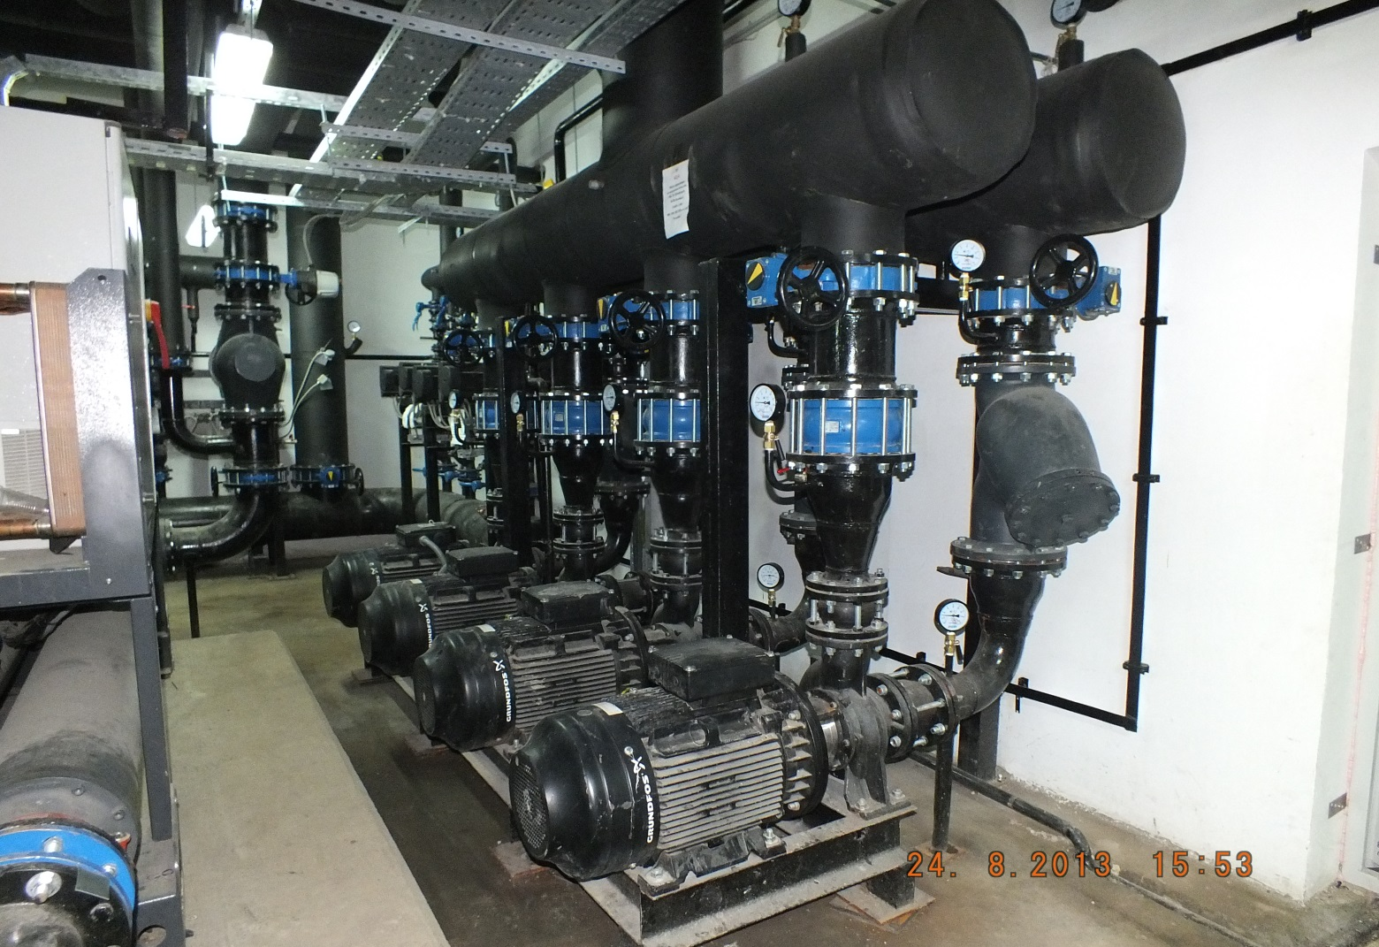
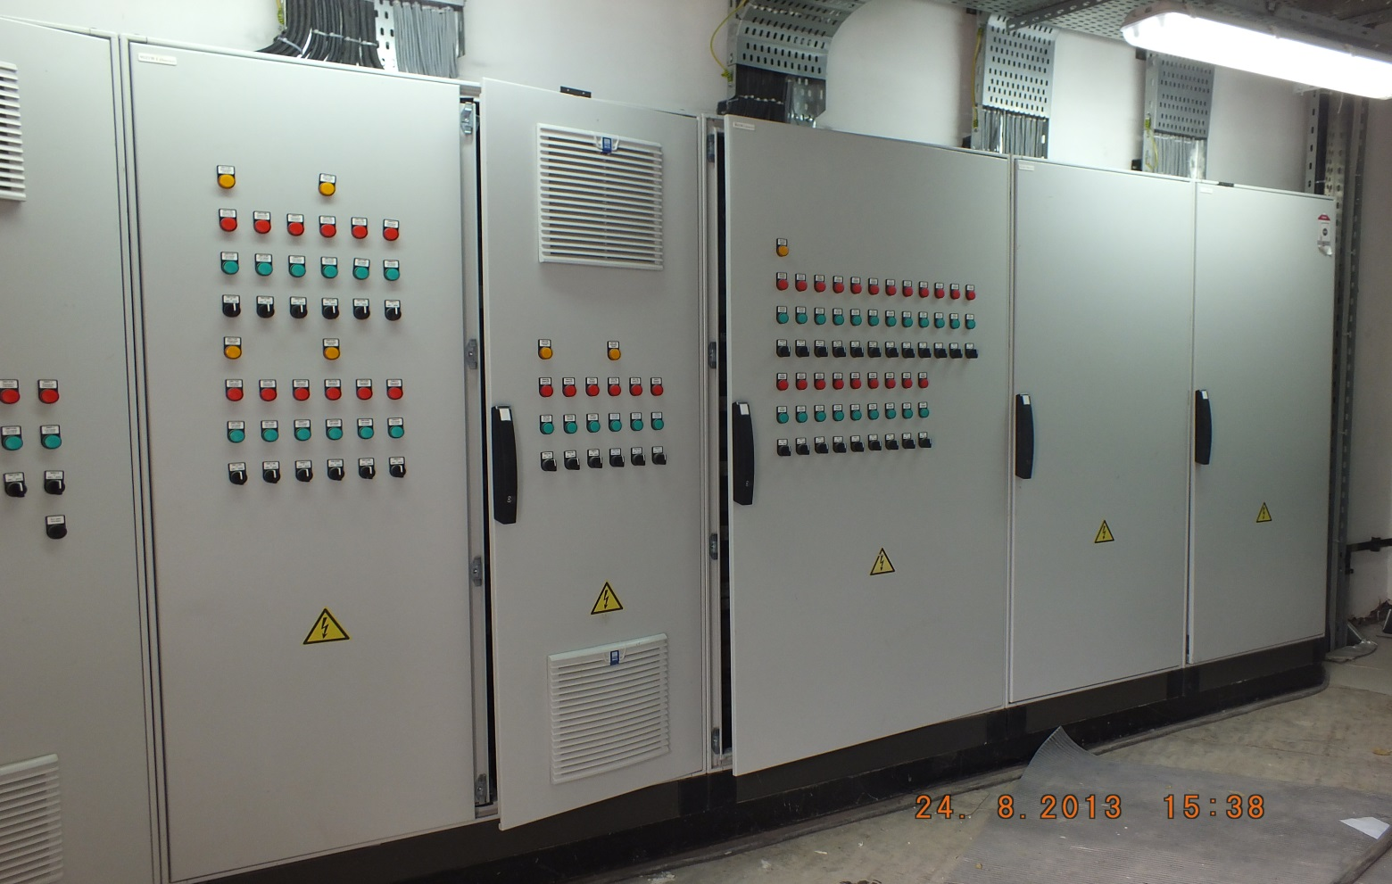

Slide 33
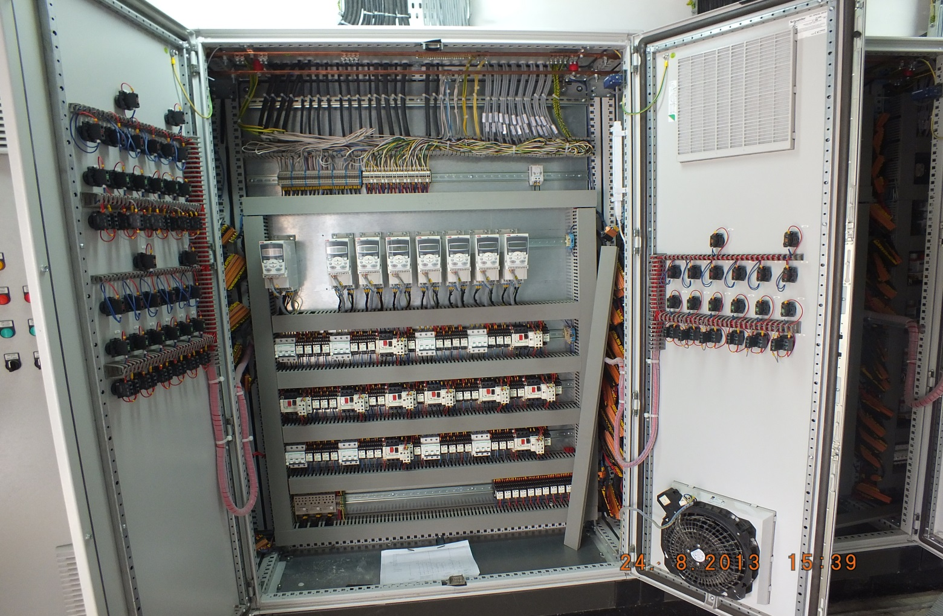
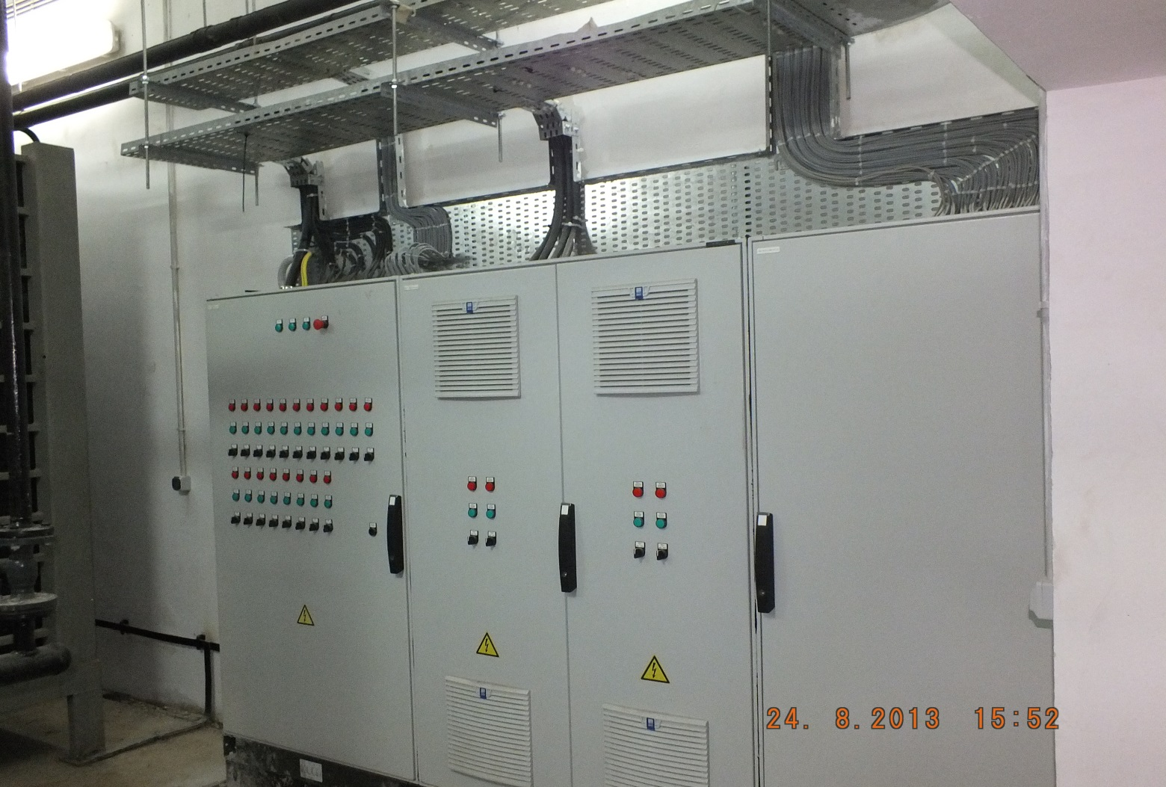

Slide 34
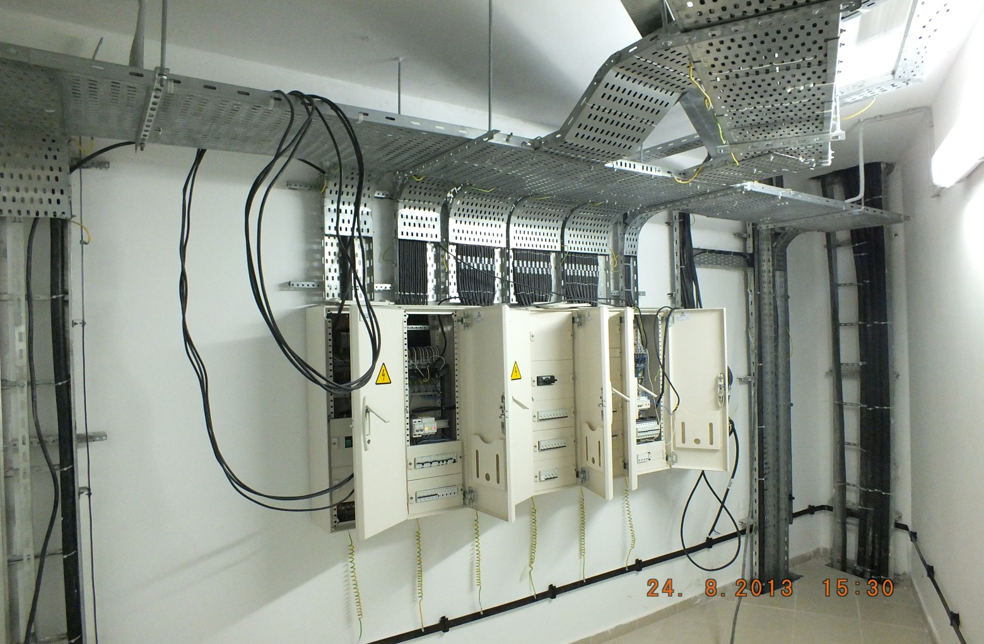
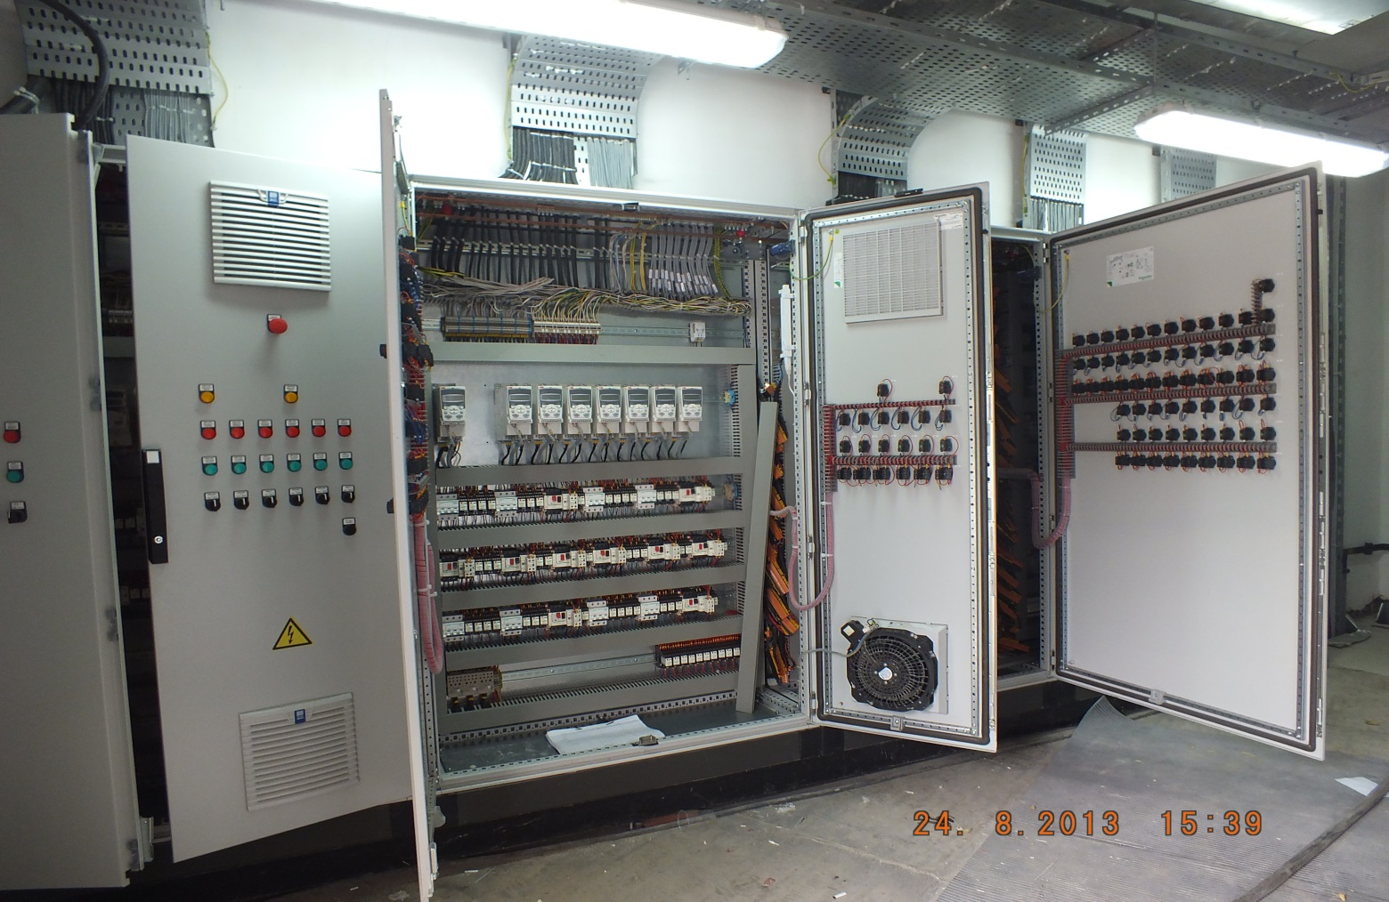

Slide 35
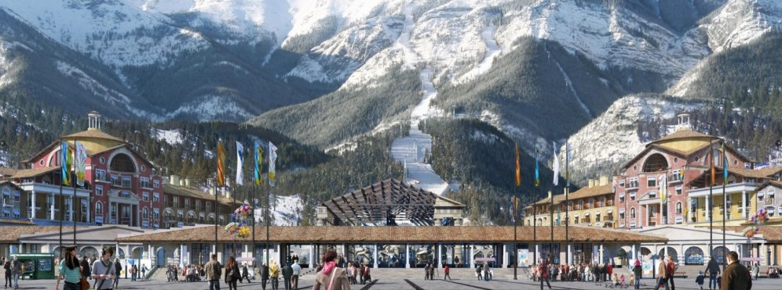
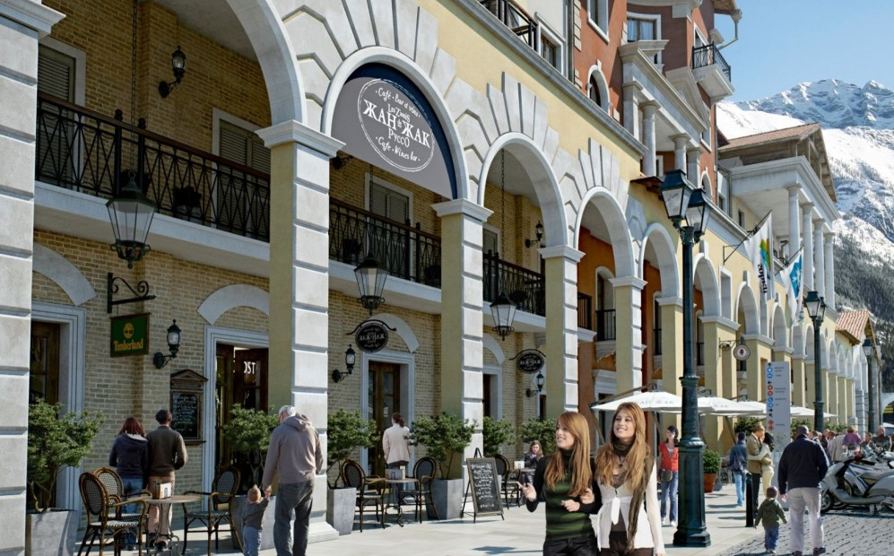
Marriott Hotel Krasnaya Polyana / Sochi (+540)

Slide 36
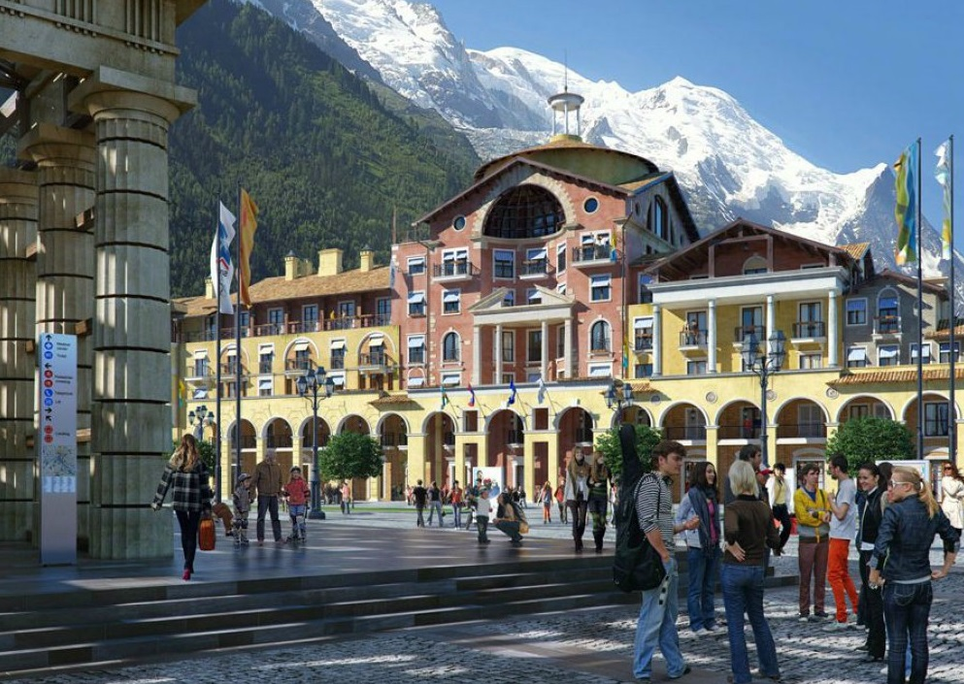

Slide 37
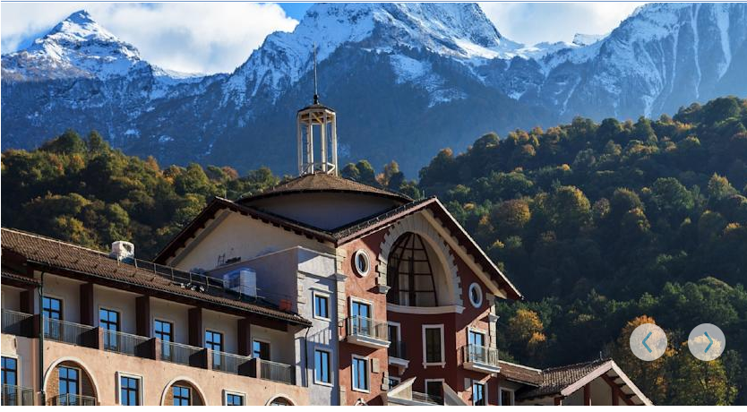
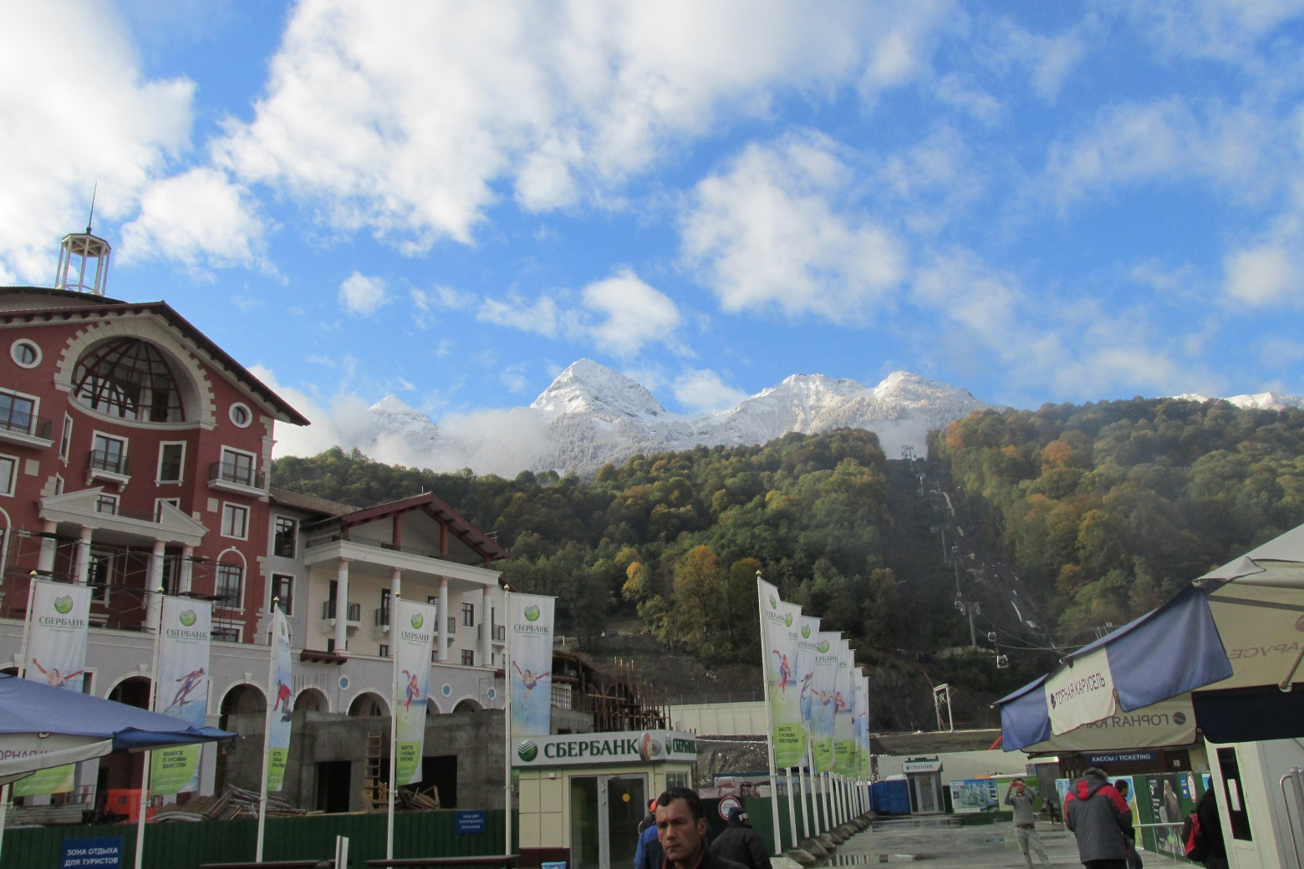

Slide 38
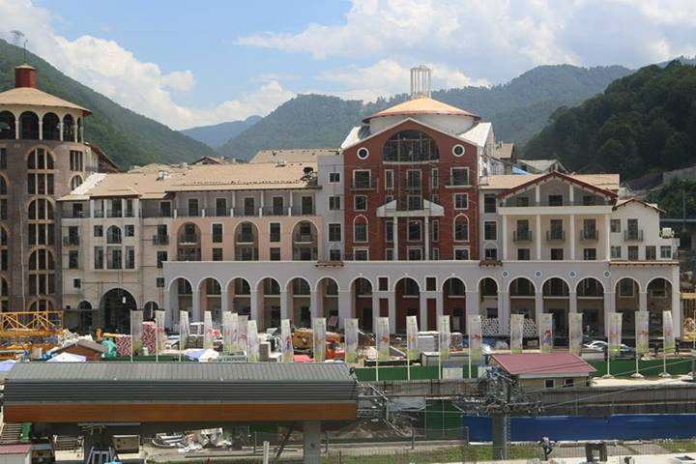
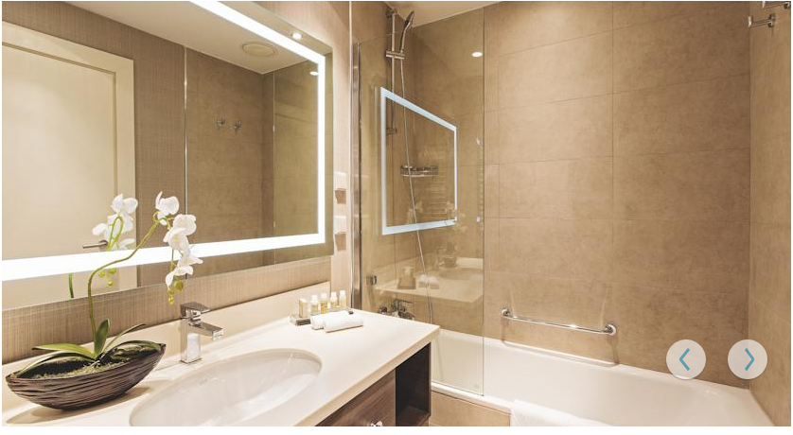

Slide 39
Rixos Apart Hotel and Residances Krasnaya Polyana / Sochi (+960)

Slide 47
Almaz shopping center Chelyabinsk

Slide 48
Sample Drawing works with AutoCAD-MEP

